Slide 1
SQL Bootcamp
Noble Desktop

Slide 2
Rob Carrington
5 years as a software developer
Worked in FinTech

Slide 3



Q2 eBanking

Slide 4
Databases from my Past
Microsoft SQL Server
Apache Cassandra
Postgres

Slide 5
Databases from my Past
Microsoft SQL Server
Apache Cassandra
Postgres

Slide 6
What about you?
Goals
Database used at work
Background

Slide 7

SQL
Reasons to learn

Slide 8
1. The Importance of data is rising

Slide 9
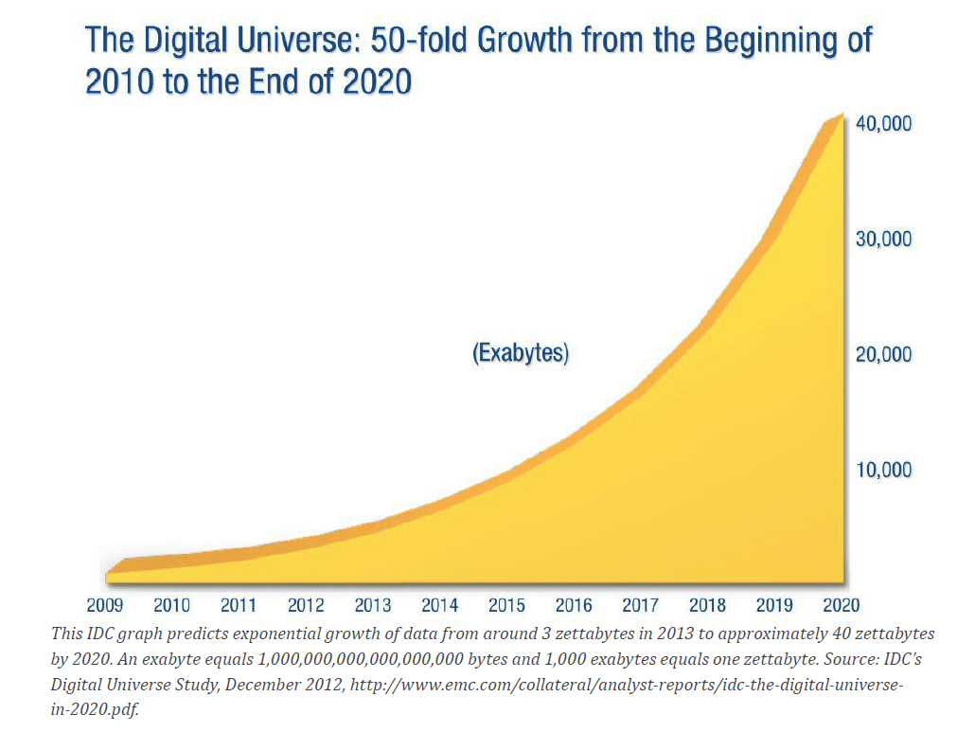
Text

Slide 10
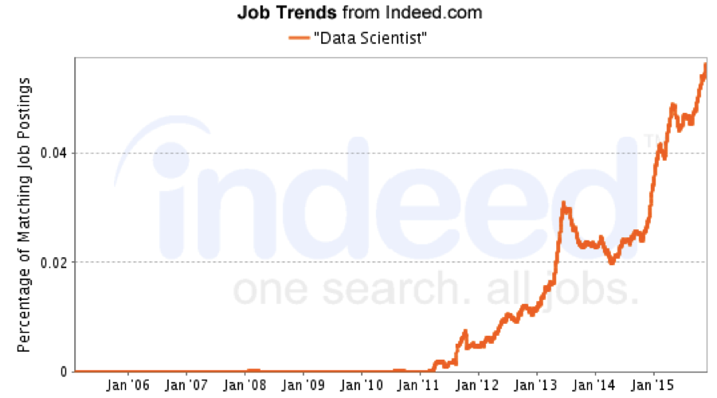

Slide 11

“Without big data analytics, companies are blind and deaf, wandering out onto the web like deer on a freeway.”
Geoffrey Moore

Slide 12
2. SQL is a core skill for using data

Slide 13
Advantages of SQL
Evergreen skill
Nearly identical across databases
Fast to learn, compared to other programming languages

Slide 14
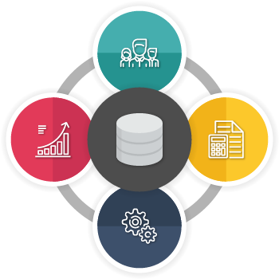
Truth
The source of

Slide 15
Uses of SQL
“Know your numbers” for any aspect of your business
Fix mistakes in database
Create backups of your data

Slide 16
Course outline

Slide 17

Class format
15 minutes for lesson & demo
15 minutes for exercise
Pause to review & ask questions
Rinse and repeat

Slide 18
Day 1
Concepts & Terminology
Navigating the DBeaver GUI
Querying for data

Slide 19
Day 2
Aggregating data
Joining data
Adding data to the database

Slide 20
Day 3
Fancy advanced topics

Slide 21
Out of scope
Schema design
High-performance use cases
Technical foundations

Slide 22
Concepts & Terminology

Slide 23
This will be on the test!

Slide 24
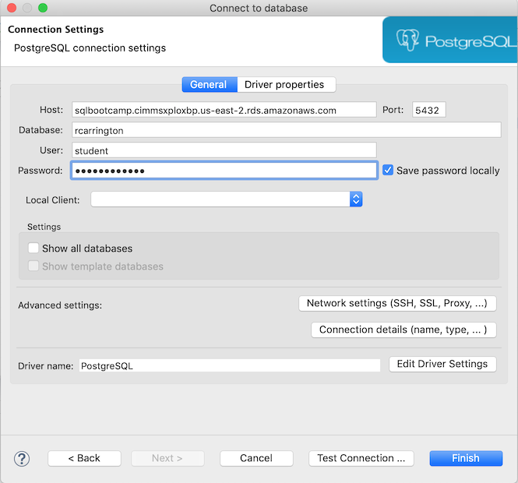

Slide 25


High-Level view
Network
Client
Server/Host

Slide 26

High-Level view

Slide 27
High-Level view
Network
Client
Server/Host

Slide 28

High-Level view
Network
DBeaver
Server/Host

Slide 29

High-Level view
Network
DBeaver
Postgres

Slide 30
High-level view
Client
Server/Host
DBeaver
Postgres

Slide 31

Server view

Slide 32
Server view
Postgres instance

Slide 33
Server view
Network

Slide 34

Server view
Port

Slide 35

“Port 5432?”
“Yes, I’ll connect you to Postgres right away.”

Slide 36

Server view
Database

Slide 37
Server view
Databases

Slide 38
Database view

Slide 39

Database view
Table aka Relation

Slide 40
Database view
Schema = set of tables

Slide 42
Quiz!

Slide 43
DBeaver Interface

Slide 44
DBeaver Interface
Browse the tables within a database
Execute a query
See the resulting data

Slide 45
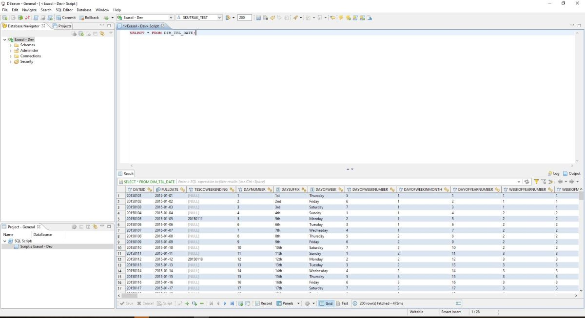
Text

Slide 46
Text
database navigator

Slide 47
Text

Slide 48
Text
SQL editor

Slide 49
Text

Slide 50
Text
Results panel

Slide 51
Walkthrough

Slide 52
Select Statement
SELECT * FROM products;

Slide 53
Select Statement
SELECT * FROM products;
table

Slide 54
Select Statement with Limit
SELECT * FROM products
LIMIT 100;

Slide 55
Specifying Columns
SELECT title, price FROM products;

Slide 56
Specifying Columns
SELECT title, price FROM products;
column

Slide 57
Distinct
SELECT DISTINCT price FROM products

Slide 58
Exercises

